Slide 1

Group10
Đặng Việt Anh - 20176686
Nguyễn Minh Tú - 20154203

Slide 2
NỘI DUNG
01
03
Introduction
Function
03
04
05
Technique
Evaluate
Conclusion
02
Design Analysis

Slide 3
01
Introduction

Slide 4
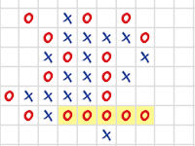

Introduction
Caro Game
Tic Tac Toe Game

Slide 5
Design Analysis
02

Slide 6
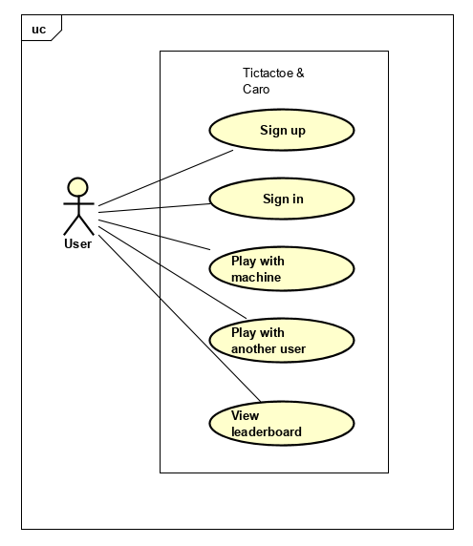
Design Analysis
Use Case Diagram
Architecture: client/server
Model architecture: many clients connect to one server (maybe develop more model between clients)
Server has mission to manage information register and exchange information with client

Slide 7
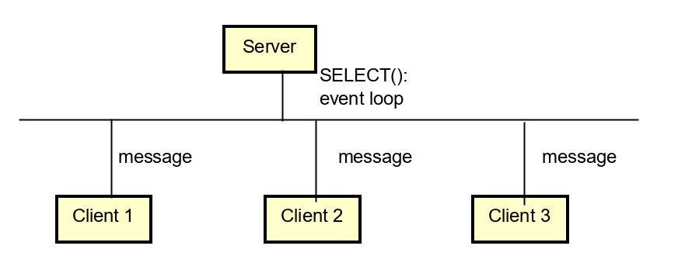
Design Analysis
Server-Client Architecture
- Event- driven socket program
- Server sits on an event loop
- Clients’ messages are handled upon arrival

Slide 8
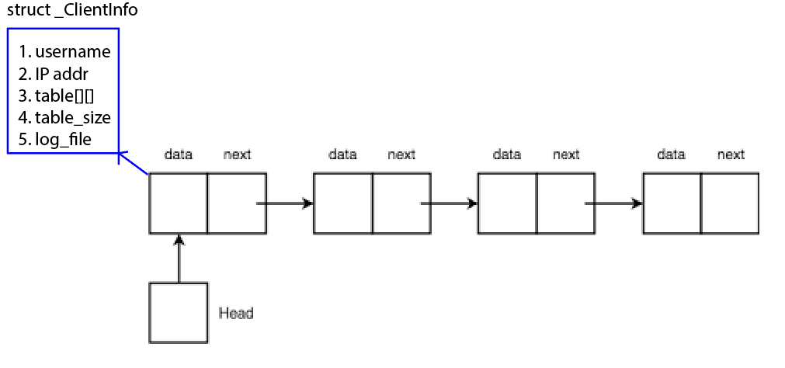
Design Analysis
Singly Linked List
- Server uses this list to store current games of different clients
- Operations: new, get, add, remove

Slide 9
Design Analysis
Communication Protocol
Messages between clients and servers are in form: SIGNAL#PARAM1#PARAM2
Signal | Param | Explaination
SIGNAL_CARO_NEWGAME | None | Client requests a new caro game
SIGNAL_CREATEUSER | Username#Password | Client wants to sign up with given name & password
SIGNAL_CARO_WIN | None | Server notifies client that he/she has won
...

Slide 10
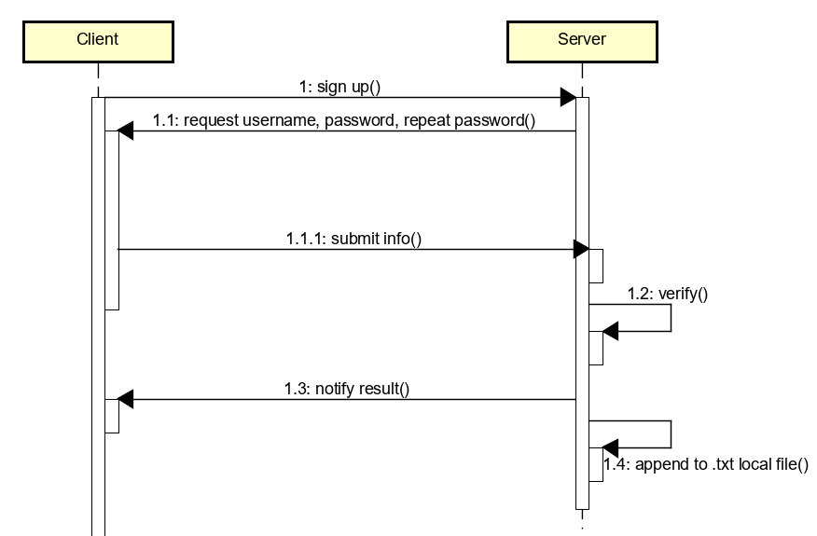
Design Analysis
Sign up

Slide 11
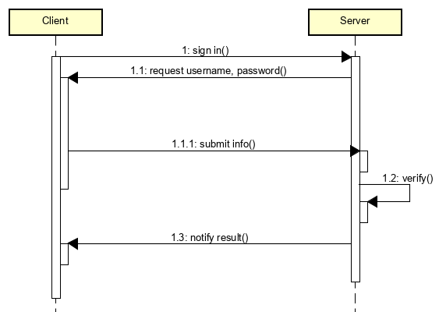
Design Analysis
Sign in

Slide 12
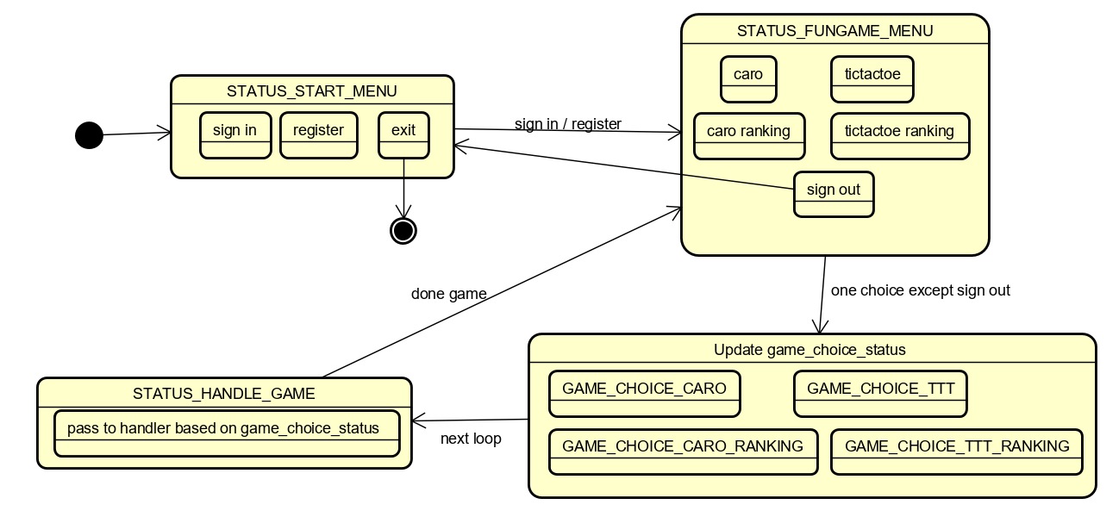
Design Analysis
Menu Navigation: Finite State Machine

Slide 13
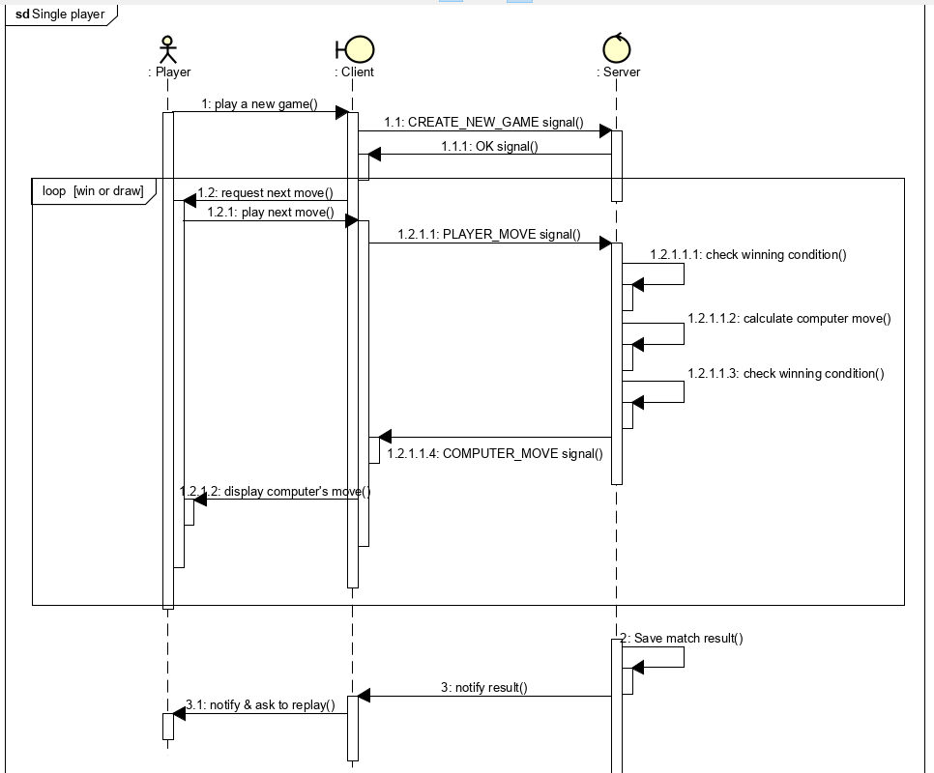
Design Analysis
Single player

Slide 14

Function
03

Slide 15
Function
Register
Sign In
Play Game
View Ranking
View Log

Slide 16

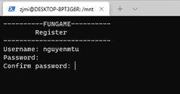
Register

Slide 17
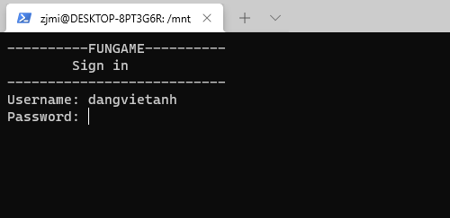
Sign In

Slide 18
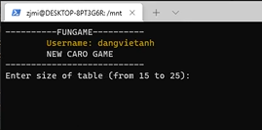
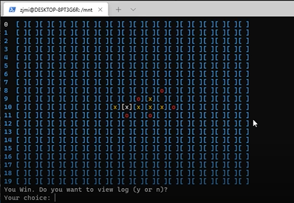
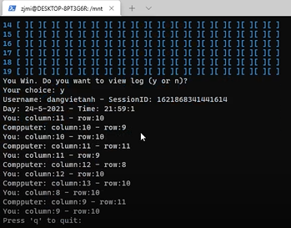
Caro Game

Slide 19
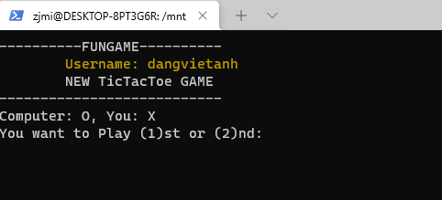
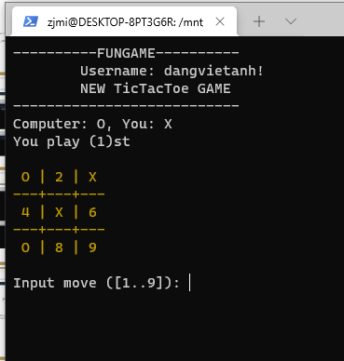
TTT Game

Slide 20
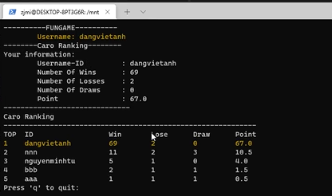
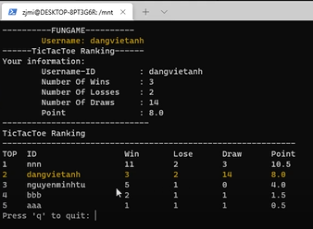
View ranking

Slide 21

04
Technique

Slide 22
Technique
Use library termios.h to hide password

Slide 23
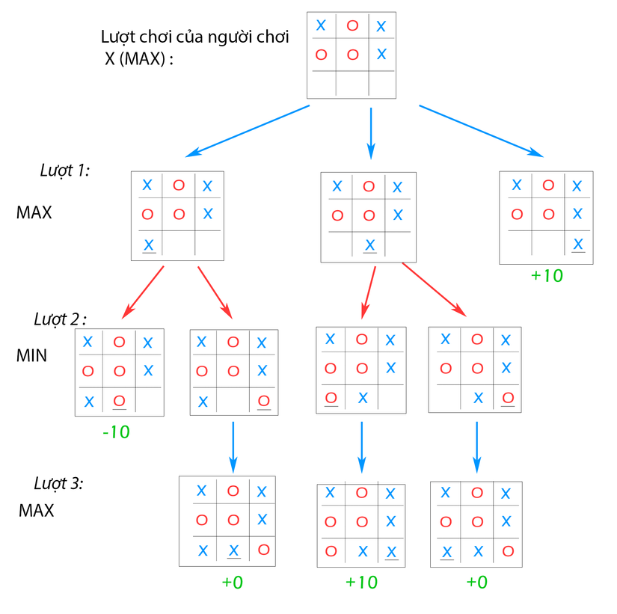
Technique
Minimax algorithm
+ MAX: Player try to win game.
+ MIN: Other player try to do that MAX get the smallest score.
Result is win, lose or tie , then MAX=10, MIN =-10 or =0 respectively
Hình 13: Cây trò chơi (Game tree)

Slide 24
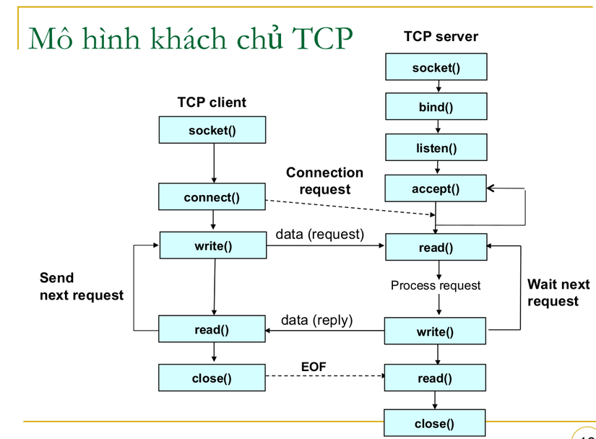
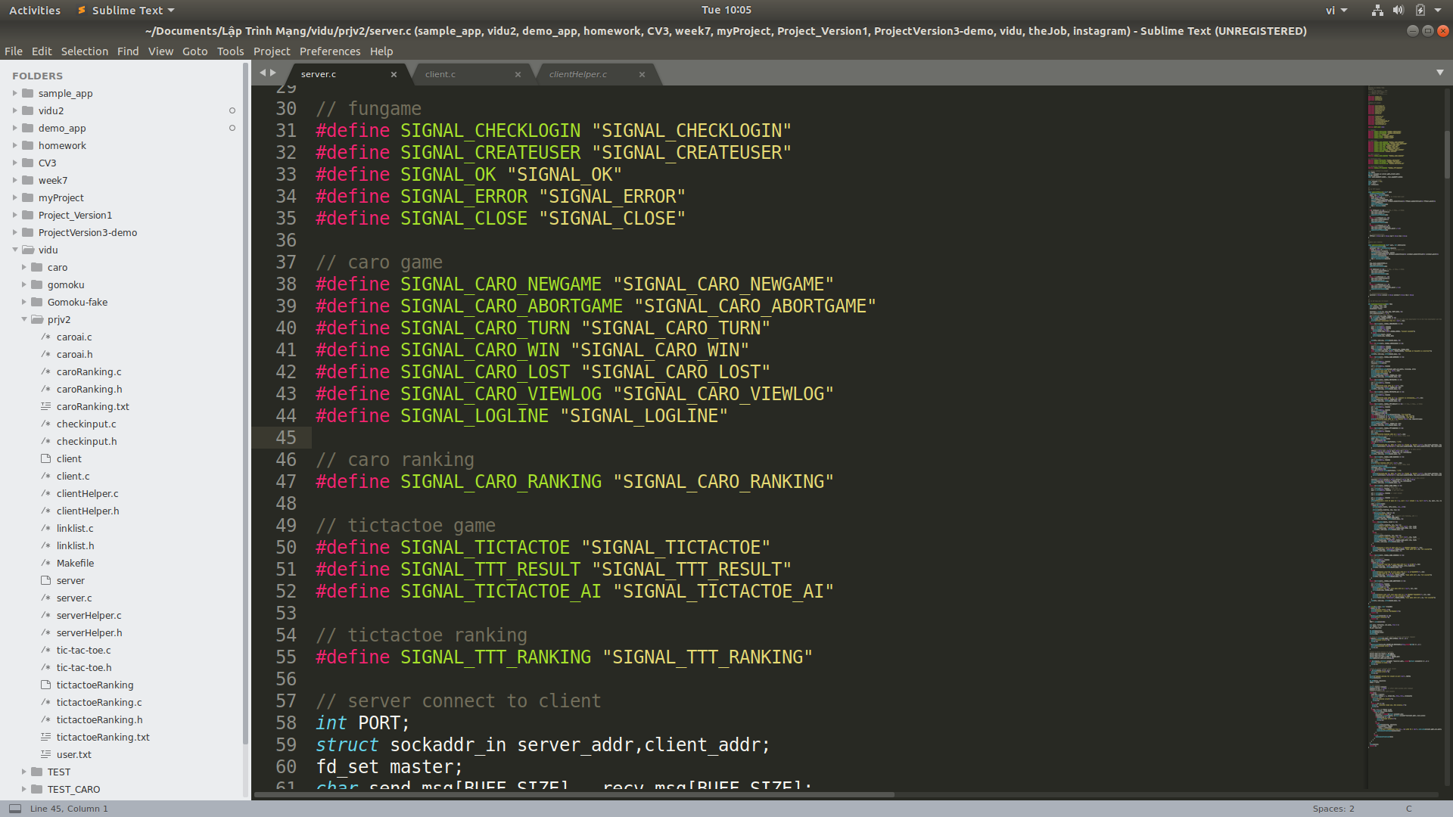
Technique
TCP connection
Many clients connect to server using select()
Notes:
Sử dụng giao thức TCP. Với Server, Server sẽ Tạo socket, Gán địa chỉ cho socket, Chỉ định socket lắng nghe kết nối. Client Tạo socket, Connect tới địa chỉ server. Server chấp nhận kết nối. Định nghĩa các tín hiệu để giúp client server có thể dễ dàng trao đổi dữ liệu.Client sẽ gửi ID của người chơi kèm với tín hiệu. Server nhận dữ liệu, xử lý và gửi kết quả về phía client để client hiển thị.

Slide 25

05
Evaluate

Slide 26
Evaluate
Program have complete functions: Sign in, register, play game, view log, view ranking
Functions activate normal, stable
Solve timeout error: Set timeout for both sides client and server

Slide 27
CLIENT
// set timeout
struct timeval timeout;
timeout.tv_sec = 20; // after 20 seconds will timeout
timeout.tv_usec = 0;
if (setsockopt (sock, SOL_SOCKET, SO_RCVTIMEO, (char *)&timeout, sizeof(timeout)) < 0){
return -1;
}
else if (setsockopt (sock, SOL_SOCKET, SO_SNDTIMEO, (char *)&timeout, sizeof(timeout)) < 0){
return -1;
}

Slide 28
SERVER
// Set timeout
struct timeval timeout;
timeout.tv_sec = 1000; // after 1000 seconds will timeout
timeout.tv_usec = 0;
//Step 4: Communicate with clients
read_fds = master;
rc = select(fdmax + 1, &read_fds, NULL, NULL, &timeout);
if( rc == -1){
perror("select() error!\n");
exit(-6);
}
else if (rc == 0){
printf(" select() timed out. End program.\n");
exit(-5);
}

Slide 29
Conclusion
06

Slide 30
Video Demo:
https://youtu.be/9_IYJvR2kPI
Source code:
https://github.com/GoodGuy69/caroPj.git

Slide 31
Work Contribution
Đặng Việt Anh (50%) | Nguyễn Minh Tú (50%)
Game logic Finite state machine menu Login-sign up logic | Game interface Design server-client communication

Slide 32
References
Slides of teacher Tran Nguyen Ngoc
“Unix-network-programming” ebook - W. Richard Stevens, Bill Fenner, Andrew M. Rudoff
Reference for termios.h library: https://www.ibm.com/support/knowledgecenter/en/SSLTBW_2.1.0/com.ibm.zos.v2r1.bpxbd00/rttcga.htm
Minimax algorithm: https://viblo.asia/p/thuat-toan-minimax-ai-trong-game-APqzeaVVzVe

Slide 33

Thanks for listening

